Slide 1
What Works Series: NEET to EET Mentoring 11th December 2024 Jade Stevens – Research Project Support Officer, Thames Valley Violence Prevention Partnership Tori Olphin, M.B.E. – Head of Data Science, Research and Evaluation, Thames Valley Violence Prevention Partnership

Slide 2
NEET to EET Mentoring Rapid Evidence Review: Why?
Early intervention for NEET young people to support with EET engagement in Thames Valley
Existing Evidence
Mentoring can support young people in making changes in attitudes and behaviours in different areas of life
Some evidence around NEET to EET mentoring (without quantity or quality)
No existing 'what works' guide or systematic review to inform intervention design
A rapid evidence review is a commonly used method to identify what evidence exists that relates to a particular problem, to identify the strengths and weaknesses of that evidence and to summarise the findings so that learning can be gained that will assist with development of policy or further research

Slide 3
Early Intervention for NEET young people:
Risks and Consequences for Young People (for longer than 6 months):
*in comparison with peers that have not been NEET by the age of 21
More likely to be unemployed, unqualified, untrained
More likely to have a criminal record
More likely to experience poor mental and physical health
More likely to become a parent
Less likely to earn as much as peers once employed
Wider Societal Risks and Consequences:
Additional lifetime financial cost to society per NEET young person is estimated to be around £56,000
Rising number of young people experiencing NEET circumstances in the UK each year; with 12.2% of young people (872,000) being NEET in 2024.
Having identified which risk indicator we wanted to target, with an idea of what type of intervention we might like to implement, this research project was conducted as the 'research scoping' stage of the research project lifecycle.

Slide 4
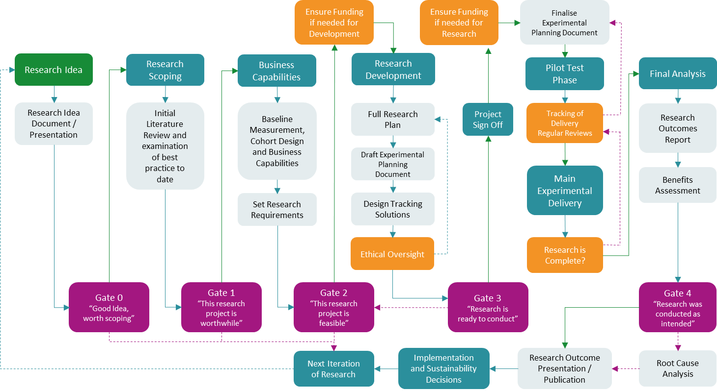
Research Project Lifecycle
Reference: Adapted from Olphin, T.P.A. (2023). Research Project Lifecycle: A Structured Approach to Conducting Research in the Public Sector. Reading, UK: Thames Valley Violence Reduction Unit. @ Crown Copyright 2023

Slide 5
Rapid Evidence Review Strategy:
Literature Rules:
Must be an evaluation of a programme, intervention or activity, For and with NEET young people (aged 13-19), where non-parental adults (or those of an older generation) built a trusted relationship with a young person and provided them with support with their engagement in employment, education and/or training (EET)
Must be published in English
Must be capable of determining whether there was an effect (randomised controlled trial or quasi-experimental design – including a control group)
Must have measured and reported on primary outcomes relating to NEET young people’s engagement with EET (such as, school attendance or gaining employment), and/or secondary outcomes relating the development of EET-related softer-skills (such as confidence improvement and future aspirations)
Quality Criteria:
A randomised controlled trial
A quasi-experimental design (including a control)
A systematic literature review with this same research design eligibility criteria

Slide 6
Rapid Evidence Review Search:
Search Locations:
Academic Databases and Search Engines
MEDLINE, PUBMED, Cinahl, Psych Info, College of Policing National Library, and Google Scholar
Websites:
Campbell Collaboration
The Youth Endowment Fund
The Education Endowment Foundation
The UK Government Research and Statistics Area for ‘Department for Education’ and ‘Department for Work and Pensions’

Slide 7
Rapid Evidence Review Search:
Search used:
(“NEET” OR “Disengaged You*”) AND (“Mentor*” OR “guide” OR “advisor” OR “problem solving” OR “problem-solving” OR “key worker” OR “case worker” OR “one-to-one support” OR “re-engagement support” OR “trusted adult” OR “role model” OR “coach*”)

Slide 8
Rapid Evidence Review Process Overview
1670
Initial Search Results
1645
Duplicates Removed
292
Titles with Clear Irrelevance Removed
29
Review of Abstracts (Summary) with Irrelevant Literature Removed
16
Full Read of Articles Ensuring Only Relevant Research Remained
8
Full Read of Articles Ensuring Only Relevant Research of High Quality Remained

Slide 9
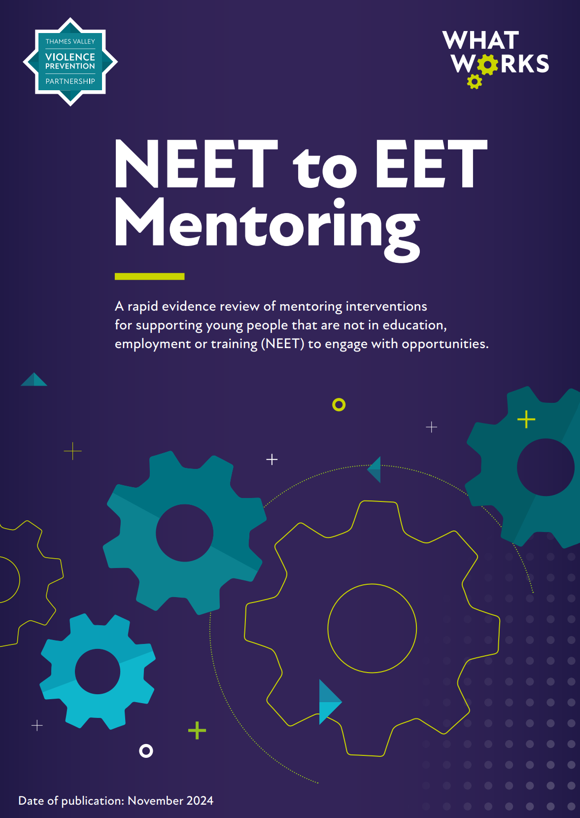
Findings of the Rapid Evidence Review
A glossy ‘What Works’ report has been circulated, but please request it to be sent to you if you have not received it already. To reference, please use:
Stevens J. & Olphin, T. (2024) What Works Series: NEET to EET Mentoring Rapid Evidence Review, Thames Valley Violence Prevention Partnership: Kidlington, UK

Slide 10
Key Findings
What does the evidence suggest could work?
Long-term intervention engagement
Multi-component interventions (Mentoring Plus)
Practical and active ‘EET’ support (e.g. CV writing with a young person)
Activity involves person-centred problem solving to remove barriers to engagement
Activity involves devising and implementing a set of short-term and long-term goals with a young person, directed by their individual wants, interests and needs
Includes referrals and/or supported applications for access to mental health support, and other wider services
Includes exposure to experiences (e.g. volunteering, work placement, careers fair)
Training for mentors
What does the evidence show does not work?
‘Light touch’ interventions (low and limited period of delivery)
Short durations for appointments / meetings / contact
Expectations for young people to conduct initial engagement activity independently
Activity directed by current skill level / opportunity availability
Activity directed by short-term ‘now’ goals only

Slide 11
Key Findings
What does the evidence suggest could work?
Long-term intervention engagement
Multi-component interventions (Mentoring Plus)
Practical and active ‘EET’ support (e.g. CV writing with a young person)
Activity involves person-centred problem solving to remove barriers to engagement
Activity involves devising and implementing a set of short-term and long-term goals with a young person, directed by their individual wants, interests and needs
Includes referrals and/or supported applications for access to mental health support, and other wider services
Includes exposure to experiences (e.g. volunteering, work placement, careers fair)
Training for mentors
What does the evidence show does not work?
‘Light touch’ interventions (low and limited period of delivery)
Short durations for appointments / meetings / contact
Expectations for young people to conduct initial engagement activity independently
Activity directed by current skill level / opportunity availability
Activity directed by short-term ‘now’ goals only

Slide 12
Mentoring Duration
What does the evidence suggest could work?
Long-term intervention engagement
Multi-component interventions (Mentoring Plus)
Practical and active ‘EET’ support (e.g. CV writing with a young person)
Activity involves person-centred problem solving to remove barriers to engagement
Activity involves devising and implementing a set of short-term and long-term goals with a young person, directed by their individual wants, interests and needs
Includes referrals and/or supported applications for access to mental health support, and other wider services
Includes exposure to experiences (e.g. volunteering, work placement, careers fair)
Training for mentors
What does the evidence show does not work?
‘Light touch’ interventions (low and limited period of delivery)
Short durations for appointments / meetings / contact
Expectations for young people to conduct initial engagement activity independently
Activity directed by current skill level / opportunity availability
Activity directed by short-term ‘now’ goals only
Limited Periods of Delivery
('one size fits all' approaches to pre-setting closing dates for engagement; e.g. X weeks)
Low Quantity of Delivery
(one meeting per month for X months)
Frequency and Delivery to suit our busy diaries, not solving the problem

Slide 13
Mentoring Duration
What does the evidence suggest could work?
Long-term intervention engagement
Multi-component interventions (Mentoring Plus)
Practical and active ‘EET’ support (e.g. CV writing with a young person)
Activity involves person-centred problem solving to remove barriers to engagement
Activity involves devising and implementing a set of short-term and long-term goals with a young person, directed by their individual wants, interests and needs
Includes referrals and/or supported applications for access to mental health support, and other wider services
Includes exposure to experiences (e.g. volunteering, work placement, careers fair)
Training for mentors
What does the evidence show does not work?
‘Light touch’ interventions (low and limited period of delivery)
Short durations for appointments / meetings / contact
Expectations for young people to conduct initial engagement activity independently
Activity directed by current skill level / opportunity availability
Activity directed by short-term ‘now’ goals only
Short durations for appointments / meetings / contact
Low levels of contact
(less than one hour per session, with no-contact periods of more than two weeks between sessions)

Slide 14
Mentoring Duration
What does the evidence suggest could work?
Long-term intervention engagement
Multi-component interventions (Mentoring Plus)
Practical and active ‘EET’ support (e.g. CV writing with a young person)
Activity involves person-centred problem solving to remove barriers to engagement
Activity involves devising and implementing a set of short-term and long-term goals with a young person, directed by their individual wants, interests and needs
Includes referrals and/or supported applications for access to mental health support, and other wider services
Includes exposure to experiences (e.g. volunteering, work placement, careers fair)
Training for mentors
What does the evidence show does not work?
‘Light touch’ interventions (low and limited period of delivery)
Short durations for appointments / meetings / contact
Expectations for young people to conduct initial engagement activity independently
Activity directed by current skill level / opportunity availability
Activity directed by short-term ‘now’ goals only
Long term engagement
(significant periods of engagement (months to years) enabled as individual need-dependent)
Regular and meaningful contact
(at least one hour per session, with no-contact periods of two weeks or less between sessions)
Contact rate as needed to support the individual

Slide 15
Mentoring Content and Activity
What does the evidence suggest could work?
Long-term intervention engagement
Multi-component interventions (Mentoring Plus)
Practical and active ‘EET’ support (e.g. CV writing with a young person)
Activity involves person-centred problem solving to remove barriers to engagement
Activity involves devising and implementing a set of short-term and long-term goals with a young person, directed by their individual wants, interests and needs
Includes referrals and/or supported applications for access to mental health support, and other wider services
Includes exposure to experiences (e.g. volunteering, work placement, careers fair)
Training for mentors
What does the evidence show does not work?
‘Light touch’ interventions (low and limited period of delivery)
Short durations for appointments / meetings / contact
Expectations for young people to conduct initial engagement activity independently
Activity directed by current skill level / opportunity availability
Activity directed by short-term ‘now’ goals only
Single component mentoring interventions
Face to face discussion element delivery only; with a lack of problem solving (can look like tick box or form filling)
Expectations for young people to conduct initial engagement activity independently

Slide 16
Mentoring Content and Activity
What does the evidence suggest could work?
Long-term intervention engagement
Multi-component interventions (Mentoring Plus)
Practical and active ‘EET’ support (e.g. CV writing with a young person)
Activity involves person-centred problem solving to remove barriers to engagement
Activity involves devising and implementing a set of short-term and long-term goals with a young person, directed by their individual wants, interests and needs
Includes referrals and/or supported applications for access to mental health support, and other wider services
Includes exposure to experiences (e.g. volunteering, work placement, careers fair)
Training for mentors
What does the evidence show does not work?
‘Light touch’ interventions (low and limited period of delivery)
Short durations for appointments / meetings / contact
Expectations for young people to conduct initial engagement activity independently
Activity directed by current skill level / opportunity availability
Activity directed by short-term ‘now’ goals only
Multi-component interventions (Mentoring Plus)
In-depth delivery
(Person-centred approach; positioning an individual young person's unique needs and preferences as the focus of mentoring direction, content and activity)

Slide 17
Mentoring Content and Activity
What does the evidence suggest could work?
Long-term intervention engagement
Multi-component interventions (Mentoring Plus)
Practical and active ‘EET’ support (e.g. CV writing with a young person)
Activity involves person-centred problem solving to remove barriers to engagement
Activity involves devising and implementing a set of short-term and long-term goals with a young person, directed by their individual wants, interests and needs
Includes referrals and/or supported applications for access to mental health support, and other wider services
Includes exposure to experiences (e.g. volunteering, work placement, careers fair)
Training for mentors
What does the evidence show does not work?
‘Light touch’ interventions (low and limited period of delivery)
Short durations for appointments / meetings / contact
Expectations for young people to conduct initial engagement activity independently
Activity directed by current skill level / opportunity availability
Activity directed by short-term ‘now’ goals only
Sessions include a provision of practical and active 'EET engagement' support
(e.g. CV writing with a young person, collaboratively searching for EET opportunities, supporting them in conversations with college tutors)

Slide 18
Mentoring Content and Activity
What does the evidence suggest could work?
Long-term intervention engagement
Multi-component interventions (Mentoring Plus)
Practical and active ‘EET’ support (e.g. CV writing with a young person)
Activity involves person-centred problem solving to remove barriers to engagement
Activity involves devising and implementing a set of short-term and long-term goals with a young person, directed by their individual wants, interests and needs
Includes referrals and/or supported applications for access to mental health support, and other wider services
Includes exposure to experiences (e.g. volunteering, work placement, careers fair)
Training for mentors
What does the evidence show does not work?
‘Light touch’ interventions (low and limited period of delivery)
Short durations for appointments / meetings / contact
Expectations for young people to conduct initial engagement activity independently
Activity directed by current skill level / opportunity availability
Activity directed by short-term ‘now’ goals only
Time is taken in mentoring to identify a young person's barriers to EET engagement and problem-solving is applied collaboratively to remove barriers
A young person's needs are considered holistically

Slide 19
Mentoring Content and Activity
What does the evidence suggest could work?
Long-term intervention engagement
Multi-component interventions (Mentoring Plus)
Practical and active ‘EET’ support (e.g. CV writing with a young person)
Activity involves person-centred problem solving to remove barriers to engagement
Activity involves devising and implementing a set of short-term and long-term goals with a young person, directed by their individual wants, interests and needs
Includes referrals and/or supported applications for access to mental health support, and other wider services
Includes exposure to experiences (e.g. volunteering, work placement, careers fair)
Training for mentors
What does the evidence show does not work?
‘Light touch’ interventions (low and limited period of delivery)
Short durations for appointments / meetings / contact
Expectations for young people to conduct initial engagement activity independently
Activity directed by current skill level / opportunity availability
Activity directed by short-term ‘now’ goals only
Mentoring focused on access to the easiest available opportunities
Mentoring focused on opportunities aligned with a young person's current skill level, rather than their interests and goals for where they want to be

Slide 20
Mentoring Aims
What does the evidence suggest could work?
Long-term intervention engagement
Multi-component interventions (Mentoring Plus)
Practical and active ‘EET’ support (e.g. CV writing with a young person)
Activity involves person-centred problem solving to remove barriers to engagement
Activity involves devising and implementing a set of short-term and long-term goals with a young person, directed by their individual wants, interests and needs
Includes referrals and/or supported applications for access to mental health support, and other wider services
Includes exposure to experiences (e.g. volunteering, work placement, careers fair)
Training for mentors
What does the evidence show does not work?
‘Light touch’ interventions (low and limited period of delivery)
Short durations for appointments / meetings / contact
Expectations for young people to conduct initial engagement activity independently
Activity directed by current skill level / opportunity availability
Activity directed by short-term ‘now’ goals only
Goal setting is directed by the short-term and fast transition of a young person from NEET to EET
No consideration for a young person's future or career prospects
'Our goals, not theirs'

Slide 21
Mentoring Content and Activity
What does the evidence suggest could work?
Long-term intervention engagement
Multi-component interventions (Mentoring Plus)
Practical and active ‘EET’ support (e.g. CV writing with a young person)
Activity involves person-centred problem solving to remove barriers to engagement
Activity involves devising and implementing a set of short-term and long-term goals with a young person, directed by their individual wants, interests and needs
Includes referrals and/or supported applications for access to mental health support, and other wider services
Includes exposure to experiences (e.g. volunteering, work placement, careers fair)
Training for mentors
What does the evidence show does not work?
‘Light touch’ interventions (low and limited period of delivery)
Short durations for appointments / meetings / contact
Expectations for young people to conduct initial engagement activity independently
Activity directed by current skill level / opportunity availability
Activity directed by short-term ‘now’ goals only
Keep young people’s careers, futures and any individual barriers to engagement in mind, as shaped by their individual and unique wants, interests and needs
Consider the young person holistically in collaborating with them to plan and progress towards achieving their potential
Meaningful EET opportunities

Slide 22
Mentoring Content and Activity
What does the evidence suggest could work?
Long-term intervention engagement
Multi-component interventions (Mentoring Plus)
Practical and active ‘EET’ support (e.g. CV writing with a young person)
Activity involves person-centred problem solving to remove barriers to engagement
Activity involves devising and implementing a set of short-term and long-term goals with a young person, directed by their individual wants, interests and needs
Includes referrals and/or supported applications for access to mental health support, and other wider services
Includes exposure to experiences (e.g. volunteering, work placement, careers fair)
Training for mentors
What does the evidence show does not work?
‘Light touch’ interventions (low and limited period of delivery)
Short durations for appointments / meetings / contact
Expectations for young people to conduct initial engagement activity independently
Activity directed by current skill level / opportunity availability
Activity directed by short-term ‘now’ goals only
Assist the young person in finding support that helps to remove or reduce barriers
Being NEET is often not the only difficulty in a young person's life, so we should support the young person holistically

Slide 23
Mentoring Content and Activity
What does the evidence suggest could work?
Long-term intervention engagement
Multi-component interventions (Mentoring Plus)
Practical and active ‘EET’ support (e.g. CV writing with a young person)
Activity involves person-centred problem solving to remove barriers to engagement
Activity involves devising and implementing a set of short-term and long-term goals with a young person, directed by their individual wants, interests and needs
Includes referrals and/or supported applications for access to mental health support, and other wider services
Includes exposure to experiences (e.g. volunteering, work placement, careers fair)
Training for mentors
What does the evidence show does not work?
‘Light touch’ interventions (low and limited period of delivery)
Short durations for appointments / meetings / contact
Expectations for young people to conduct initial engagement activity independently
Activity directed by current skill level / opportunity availability
Activity directed by short-term ‘now’ goals only
Making it known that there are opportunities that the young person can take advantage of
Hope and excitement are powerful

Slide 24
Mentoring Content and Activity
What does the evidence suggest could work?
Long-term intervention engagement
Multi-component interventions (Mentoring Plus)
Practical and active ‘EET’ support (e.g. CV writing with a young person)
Activity involves person-centred problem solving to remove barriers to engagement
Activity involves devising and implementing a set of short-term and long-term goals with a young person, directed by their individual wants, interests and needs
Includes referrals and/or supported applications for access to mental health support, and other wider services
Includes exposure to experiences (e.g. volunteering, work placement, careers fair)
Training for mentors
What does the evidence show does not work?
‘Light touch’ interventions (low and limited period of delivery)
Short durations for appointments / meetings / contact
Expectations for young people to conduct initial engagement activity independently
Activity directed by current skill level / opportunity availability
Activity directed by short-term ‘now’ goals only
Training should be provided both in mentoring skills, but also in skills to assist the young person with becoming EET; such as:
Awareness of education options
CV writing
Job searching

Slide 25
Backfire Effects
Doing the things in the pink boxes above
could be worse than doing nothing:
Increase Vulnerabilities
Left open to exploitation
Uncertainty of future
Engagement in low quality employment:
Employment without training
Zero-hour contracts

Slide 26
It is possible to design things that are more likely to succeed:
Person Centred
Problem Solving
Practical Support
Based on Wants, Needs and Goals
Long-term with duration to suit person
In-depth, Multi-component
Remove barriers

Slide 27
What does this mean...
Make the most of resources:
Funding and Time in the Public Sector
Time and Appetite of the Young Person
Need to design interventions that have best chance of working or we:
Waste money and time (everyone's)
Damage trust that we are there to help
Damage Legitimacy

Slide 28
What should we do...
Use to Improve Intervention Design
Spot where we can improve
Recognise areas of good (and less good) practice
Improve our cohort identification
Test New Approaches and Add to the Evidence
We still need to evidence:
what works best
at what dosage
in which cohorts

Slide 29
Watch This Space... Ignite Mentoring Programme

Slide 30
What all of this means together...
Maximise What Works
Person Centred
Problem Solving
Practical Support
Based on Wants, Needs and Goals
Long-term with duration to suit person
In-depth, Multi-component
Remove barriers
59% Reduction in Knife Offending in under 18s
Stronger results despite more complicated outcome
12 months
Anything relevant that would help the young person
Entirely person-centred
In-depth
Duration to suit person
Remove barriers and aid legitimacy
Practical Support where needed
17.5% Reduction in Suspension Rate
Good results, but not as strong as Focused Deterrence, despite less complicated outcome
Person-centred
In-depth
Practical Support
7 mentoring sessions
Fixed duration - 30min

Slide 31
What all of this means together...
There seems to be a lot in common between different unwanted outcomes
So many common themes to what works
More complicated outcome to prevent = more/better problem solving needed
Starting to look like the more positive elements, the better the intervention
Person-centred problem-solving approaches seem to be worth testing and investing in

Slide 32
Pause for Thought...
It is possible to think about each of the problems we are trying to solve, and the interventions we are using to try to solve them...
How complicated are the outcomes?
Are our interventions set up for success?
Do we know to what degree they work, and how effective they are?
Can we find areas we need to test?
How might we be more effective?

Slide 33
Questions

